Slide 1
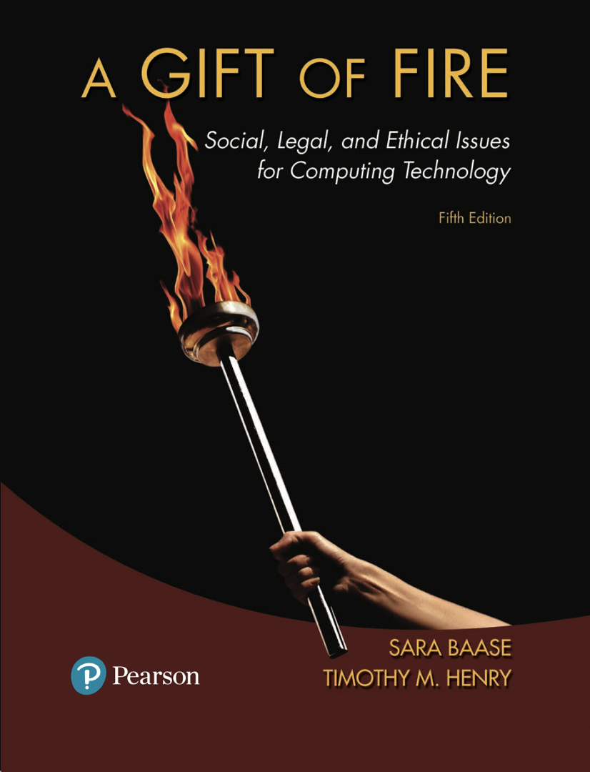
CMPS 310
Lecture 6
Chapter 3 Part 1:
1st Amendment; Controlling Speech; Legal but Objectionable
Based on slides prepared by Cyndi Chie, Sarah Frye and Sharon Gray.
Fifth edition updated by Timothy Henry
Notes:
Freedom of Speech Chapter

Slide 2

Communication Paradigms (1st Amendment)
Controlling Speech
Legal but Objectionable Content
Posting, Selling, and Leaking Sensitive Material
Anonymity
The Global Net: Censorship and Political Freedom
Net Neutrality Regulations or the Market?

Slide 3

An Issue Near And Dear to US Citizens

Slide 4
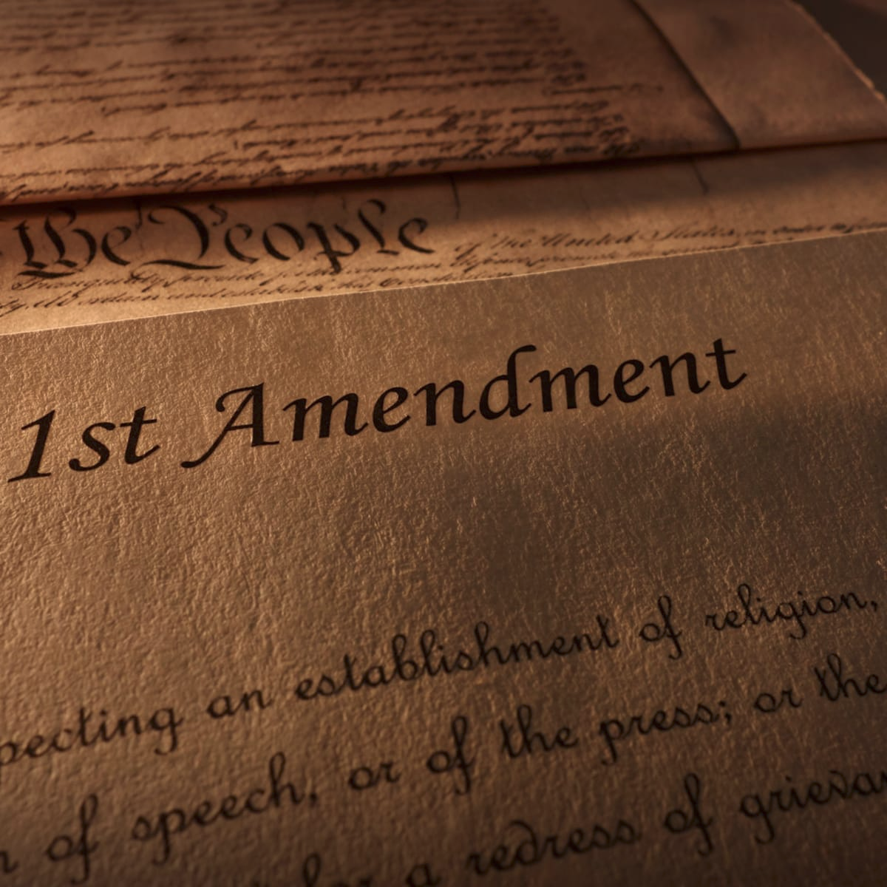

Slide 5
The 1st Amendment
Congress shall make no law respecting an establishment of religion, or prohibiting the free exercise thereof; or abridging the freedom of speech, or of the press; or the right of the people peaceably to assemble, and to petition the Government for a redress of grievances

Slide 6

Regulating communications media
First Amendment protection and government regulation
Print media (newspapers, magazines, books)
Broadcast (television, radio)
Common carriers (telephones, postal system)
Strongest 1st Amendment Protections
Notes:
JBM: over time things aren’t always in print anymore, so how do new technologies fall under 1st amendment?
Print:
Has strongest First Amendment protection
Trend toward fewer government restraints on printed words
Broadcast:
Government regulates structure of industry and content of programs
Government grants broadcast licenses
Federal Communication Commission (FCC) is the regulating body
Common carriers:
Provide medium of communication and make service available to everyone

Slide 7
Regulating communications media
First Amendment protection and government regulation
Print media (newspapers, magazines, books)
Broadcast (television, radio)
Common carriers (telephones, postal system)
Government has some control:
FCC Licenses
Meet standard of merit or lose license to broadcast
Notes:
JBM: over time things aren’t always in print anymore, so how do new technologies fall under 1st amendment?
Print:
Has strongest First Amendment protection
Trend toward fewer government restraints on printed words
Broadcast:
Government regulates structure of industry and content of programs
Government grants broadcast licenses
Federal Communication Commission (FCC) is the regulating body
Common carriers:
Provide medium of communication and make service available to everyone

Slide 8

FCC Censorship

Slide 9
Medium available to all
Medium regulated content is not
Regulating communications media
First Amendment protection and government regulation
Print media (newspapers, magazines, books)
Broadcast (television, radio)
Common carriers (telephones, postal system)
Notes:
JBM: over time things aren’t always in print anymore, so how do new technologies fall under 1st amendment?
Print:
Has strongest First Amendment protection
Trend toward fewer government restraints on printed words
Broadcast:
Government regulates structure of industry and content of programs
Government grants broadcast licenses
Federal Communication Commission (FCC) is the regulating body
Common carriers:
Provide medium of communication and make service available to everyone

Slide 10
Free-speech Principles
Written for offensive and/or controversial speech and ideas
Covers spoken and written words, pictures, art, and other forms of expression of ideas and opinions
Restriction on the power of government, not individuals or private businesses
Notes:
JBM Wouldn’t need 1st amendment if we weren’t protection controversial speech
Publishers do not have to publish material they consider offensive, poorly written, or unlikely to appeal to their customers for any reason. Rejection or editing by a publisher is not a violation of the writer’s First Amendment rights. Web sites, search engine companies, and magazines may decline specific advertisements if they so choose. That does not violate the advertiser’s freedom of speech.

Slide 11
Free-speech Principles
Supreme Court principles and guidelines
Advocating illegal acts is (usually) legal.
I am free to advocate that people download software illegally or jailbreak firesticks
Anonymous speech is protected.
I have the right to hide my identity online, even if a government hates use of VPNs
Some restrictions are allowed on advertising.
Libel and direct, specific threats are not protected.
Inciting violence is illegal.
Notes:
JBM: advertising is sometimes considered “second class” speech. Cigaretts not on TV anymore example
Cases in recent years have gone against the trend of treating advertising as “second class” speech. Courts have begun to rule that restrictions on truthful advertising do indeed violate the First Amendment.
Similarly, since the 1970s, the government has severely regulated political campaign speech, but recent Supreme Court decisions have restored some First Amendment protection for it.
There have been serious attempts to limit or prohibit anonymity on the Internet.

Slide 12
Free-speech Principles
Supreme Court principles and guidelines
Laws with a “chilling” effect on free speech are often considered unconstitutional
If bomb making details are made illegal on the internet, do digital fiction books involving bombs disappear if they contain factual information?
Restrictions and permit requirements (for protest/noise/etc) must be content neutral – same rules for everyone
Do not reduce adults to reading only what is fit for children.
Solve speech problems by least restrictive means.
Notes:
JBM: advertising is sometimes considered “second class” speech. Cigaretts not on TV anymore example
Cases in recent years have gone against the trend of treating advertising as “second class” speech. Courts have begun to rule that restrictions on truthful advertising do indeed violate the First Amendment.
Similarly, since the 1970s, the government has severely regulated political campaign speech, but recent Supreme Court decisions have restored some First Amendment protection for it.
There have been serious attempts to limit or prohibit anonymity on the Internet.

Slide 13
Telecommunication Act of 1996
Changed regulatory structure and removed artificial legal divisions of service areas and restrictions on services that telephone companies can provide.
No provider or user of interactive computer services shall be treated as a publisher of any information provided by another information- content provider.
Notes:
The Telecommunications Act significantly clarified the question of the liability of Internet Service Providers (ISPs) and other online service providers for content posted by third parties such as members and subscribers.
Service providers remain at risk in many countries. For example, the head of eBay in India was arrested because someone sold pornographic videos on eBay’s Indian site even though the video itself did not appear on the site and the seller violated company policy by selling them.

Slide 14

Offensive speech: What is it? What is illegal?
Answers depend on who you are.
Anti-theist arguments might offend evangelicals.
Decrying of war efforts that place blame on soldiers would upset many americans and especially veterans
Most efforts to censor the Internet focus on pornographic and other sexually explicit material
Georgia tried to ban pictures of marijuna from the internet
France banned the distribution of violent footage except via news organizations.
Notes:
The state of Georgia tried to ban pictures of marijuana from the Internet. A doctor argued for regulating medical discussion on the Net so that people would not get bad advice. The Chinese government restricts reporting of emergencies (such as major accidents or disasters) and how the government handles them. The French government approved a law banning anyone except professional journalists from recording or distributing video of acts of violence.
The distinctions between categories such as erotica, art, and pornography are not always clear, and different people have very different personal standards.

Slide 15

What was already illegal? Miller v. California (1973)
Obscenity
Depicts a sexual act against state law
Depicts these acts in a patently offensive manner that appeals to prurient interest as judged by a reasonable person using community standards
Lacks literary, artistic, social, political or scientific value
this last point is interesting, as a fictional film depicting a crime is obviously different than an actual act being depicted. What about artistic films where a crime is actually comitted in filming?
Notes:
The First Amendment does not protect obscenity, but how does one determine something is obscene? The 1973 Supreme Court Miller v. California decision established a three-part guideline for determining whether material is obscene under law. The second point – the application of community standards – was a compromise intended to avoid the problem of setting a national standard of obscenity in so large and diverse a country. Thus, small conservative or religious towns could restrict pornography to a greater extent than cosmopolitan urban areas.

Slide 16
Internet Censorship Laws & Alternatives
Communications Decency Act of 1996 (CDA)
Attempted to avoid conflict with First Amendment by focusing on children
Made it a crime to make available to anyone under 18 any obscene or indecent communication
Would disallow Bibles and Shakespeare on the web
Wanted use of Identification
Found to be unconstitutional
Restricted adult access to obscene artistic material
It was too vague and broad
It did not use the least restrictive means of accomplishing the goal of protecting children
Notes:
The CDA was found unconstitutional in American Civil Liberties Union et al. v. Janet Reno. That decision established that “the Internet deserves the highest protection from government intrusion.”
The courts found that the then newly developing filtering software was less restrictive and more desirable than censorship.

Slide 17
Internet Censorship Laws & Alternatives
Child Online Protection Act of 1998 (COPA)
More limited than CDA
Federal crime for commercial Web sites to make available to minors material “harmful to minors” as judged by community standards
Are videos of drinking harmful to minors?
Found to be unconstitutional
It was too broad
It would restrict the entire country to the standards of the most conservative community
It would have a chilling effect
Notes:
Law found to be too broad; would threaten art, news, and health sites.
Courts noted that because the Web is accessible everywhere, the community-standards provision would restrict the entire country to the standards of the most conservative community.
COPA would restrict access to a substantial amount of online speech that is lawful for adults and would have an unconstitutional chilling effect on free speech.
After more than 10 years of lawsuits and appeals, the Supreme Court declined to hear the last government appeal, and COPA died in 2009.

Slide 18
Internet Censorship Laws & Alternatives
Children's Internet Protection Act of 2000 (CIPA)
Requires schools and libraries that participate in certain federal programs to install filtering software
Upheld in court
Does not violate First Amendment since it does not require the use of filters, impose jail or fines
It sets a condition for receipt of certain federal funds
Much like private business, a terms of agreement is set
Can exercise free speech if willing to forgo funding
Con: Federal agencies can bully constituents.
Con: Adult Library users can’t search provocative material for valid reasons
Notes:
JBM: I think the distinction here is that the software had to be installed, but it could be disabled for users who wanted it so?
Federal agencies often use money as the “do it or else” deal
Outside of public schools and libraries, the trend of judicial decisions is to give the Internet First Amendment protection similar to that of print media, that is, the highest degree of protection.

Slide 19
Video Games
A California law banned sale or rental of violent video games to minors.
Do violent video games make minors violent?
Children often play “war”
Most studies do not find evidence that violent video games make minors more violent
In 2011, the Supreme Court of California ruled it violated the First Amendment.
“Disgust is not a valid basis for restricting expression”
Notes:
Some argue that the interactivity of video games has a more powerful impact on children than passively watching television or reading a violent story. Others point out that children have played at killing each other for generations. Does falling down “dead” on the grass compare to the repeated, explosive gore of a video game?
The California Supreme Court ruled that “disgust is not a valid basis for restricting expression.” The Court considered research on the impact of video games on children’s feelings of aggression and found that the impacts were small and differed little from the impact of other media.

Slide 20

Alternatives to censorship
Filters
Blocks sites with specific words, phrases or images
Parental control for sex and violence
Updated frequently but may still screen out too much or too little
Not possible to eliminate all errors
What should be blocked?

Slide 21
Alternatives to censorship
Policies
Commercial services, online communities, and social networking sites develop policies to protect members.
Video game industry developed rating system that provides an indication for parents about the amount of sex, profanity, and violence in a game.
Still there are issues
Many violent games, arguably without artistic merit were being uploaded to Steam
What should Steam’s policy be?

Slide 22
Discussion Question
Why is ‘least restrictive means’ important?
Do you consider the Internet an appropriate tool for young children? Why or why not?

Slide 23
Child Pornography
Includes pictures or videos of actual minors (children under 18) engaged in sexually explicit conduct.
Production is illegal primarily because of abuse of the actual children, not because of the impact of the content on a viewer.
So, how does animation fall under this?
What about adults playing children in movies?
What happens in the future when deepfake gets too hard to tell as fake?
Notes:
Laws against creating, possessing, or distributing child pornography predate the Internet. They cover a broad range of images, many of which would not meet the definition of illegally obscene material if the person depicted were an adult.
The mere possession of child pornography does not directly abuse children, but the Supreme Court accepted the ban on possession on the argument that the buyers or users of the images encourage their production.
Law enforcement agents use surveillance, search warrants, sting operations, and undercover investigations to build their cases and make arrests.

Slide 24
Child Pornography
Congress extended the law against child pornography to include “virtual” child pornography.
The Supreme Court ruled the law violated the First Amendment.
The Court accepted a later law providing harsh penalties for certain categories of computer-generated and cartoon-type images.
Notes:
“Virtual” child pornography includes computer-generated images that appear to be minors, as well as other images where real adults appear to be minors.

Slide 25
Sexting
Sending sexually suggestive or explicit text or photos, usually by cellphone or social media
Most people don’t understand the permanency of images on networks.
Can meet the definition of child pornography if subject is under 18
Should two 17 year olds be arrested for sending photos to each other?
What about a 17 year old and 18 year old?
Notes:
Many young people (like many adults) do not think about how quickly something intended for one person or small group spreads to a large audience, or how difficult it is to remove something from cyberspace once it is out there.
Possession of child pornography is illegal, so children who have pictures of friends under 18 on their phones that prosecutors think meet the definition of child pornography are potentially in violation. Should it be a criminal felony with severe penalties that can include being put in a sex-offender database for many years?
What other mechanisms (besides child pornography laws) can we use to discourage sexting?
Legislatures in a few states have revised their state’s law in a variety of ways to reduce the penalties for sexting. Some have made it a misdemeanor, rather than a felony, if a younger person sends an illegal photo to another young person of similar age. Some have reduced or eliminated penalties if photos were distributed (among minors) with the consent of the person in the picture.

Slide 26
Spam
What’s the problem?
Loosely described as unsolicited bulk email
Mostly commercial advertisement
Angers people because of content and the way it’s sent
Free speech issues
Spam imposes a cost on recipients
Spam filters do not violate free speech (free speech does not require anyone to listen)
Notes:
The term spam, in the context of electronic communications, was adopted in the 1990s to mean unsolicited bulk email. It now applies to text messages, tweets, and phone calls as well.
Spam developed because email is extremely cheap compared to printed direct-mail advertising.

Slide 27
Spam
Anti-spam Laws
Controlling the Assault of Non-Solicited Pornography and Marketing Act (CAN-SPAM Act)
Targets commercial spam
Criticized for not banning all spam, legitimized commercial spam
Notes:
The CAN-SPAM act covers labeling of advertising messages (for easier filtering), opt-out provisions, and methods of generating emailing lists.
Commercial messages must include:
valid mail header information (that is, not faking the “From” line to disguise the sender is prohibited)
valid return address
clear and honest subject lines

